Slide 1
CCBS - SYSTEM
Date: 2023｜01｜23
Prepared by: Pedro Sena / Rafael Camurça

Slide 2
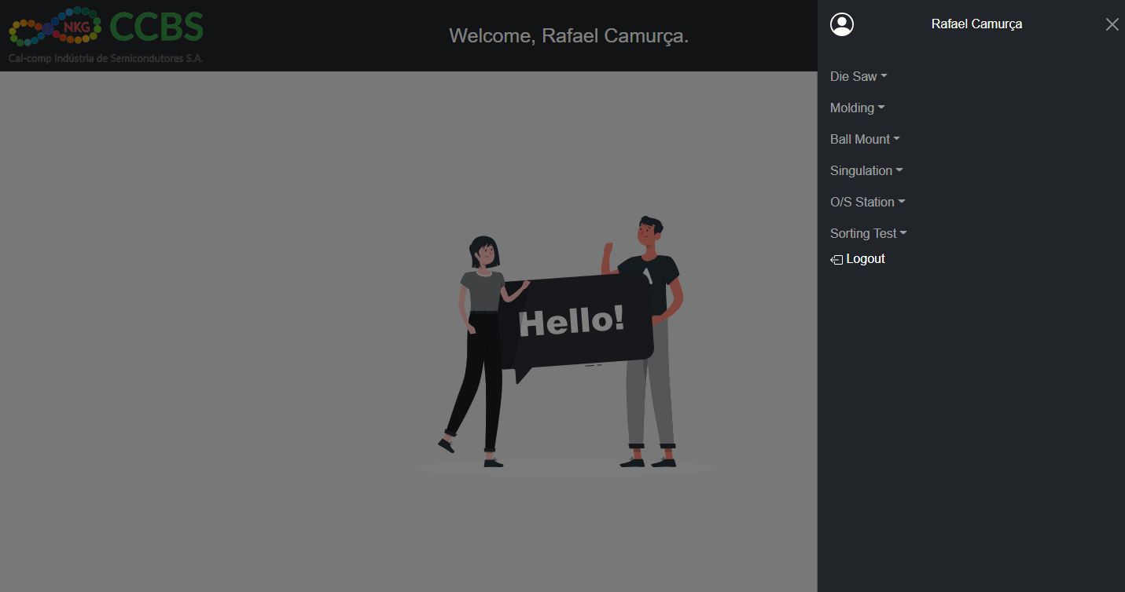
1
2
3
4
5
6
6 – Sorting Test: Daily Report for production ADTB or PHISON . Release

Slide 3
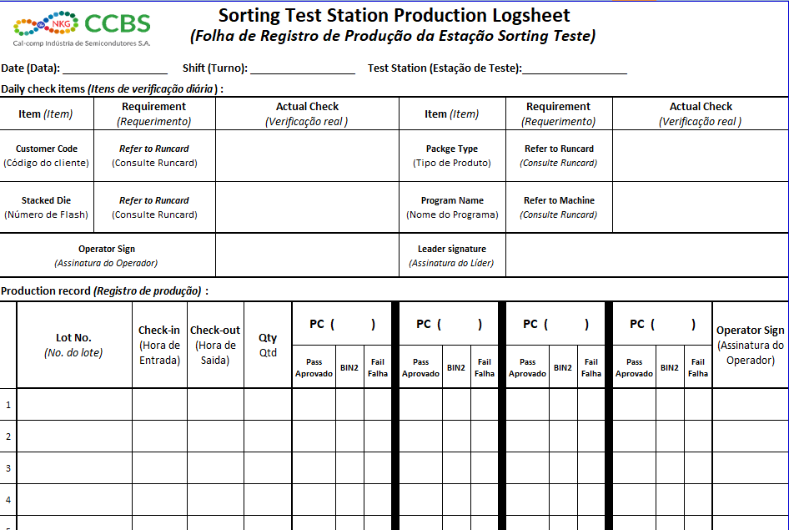
First as it is performed today.
The form is used: FR-EG-BEP Rev04 07/07/2022
It is done manually, using pen, paper and the results collected by the employees.
You have to write, all fields marked in red on the form.
In yellow, after each end of cycle, employees must fill in according to the result of the program and referring to which RunCard they are working on.

Slide 4
First as it is performed today.
The form is used: FR-EG-BEP Rev04 07/07/2022
It is done manually, using pen, paper and the results collected by the employees.
Generally, a sheet of paper is used for each workbench, where data from 2 computers are entered.
We currently have 7 benches with 2 computers, that is 7 sheets.
If there are errors they need to redo the reports again. There are always erasures in which it is necessary to redo the report.
If more than 20 cycles are performed per computer, 2 sheets will be used. A total of 14 sheets will be used per shift.
1 day (3 shifts) so there will be 42 sheets. 1 week-5 days (3 shifts) 210 sheets will be used. 1 Month-20 days (3 shifts) 840 sheets will be used.
Remembering that excluding weekends and without erasures that need to redo the report completely. We have these results mentioned above.

Slide 5
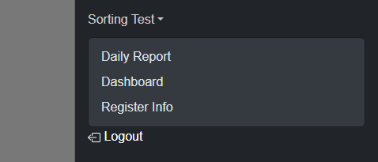
Now let's come to a solution found.
1
2
3
We will have 3 tabs.
Tab number 1(Daily Report) will be the tab available for employees to enter and send data.
Tab number 2 (Dashboard), will be where it will show the graphs referring to the collected data that were inserted by the employees.
And Tab number 3 (Register Info), will be a complementary Tab to Tab number 1, as it is in this Tab that the RunCard data will be entered manually only once by Lot Mother.

Slide 6
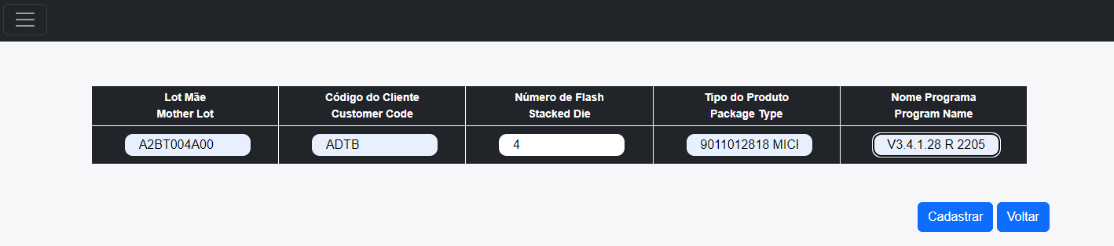
We'll start with Tab Number 3, because this is where it starts. One person (Process Leader or 1 employee) will have access to this Tab to enter, register Lot Mother data, so that when the Daily Report is carried out, the data is entered automatically.
The Mother Lot, Customer Code, Flash Number, Product Type and Program Name will be inserted, as shown in the image above.

Slide 7
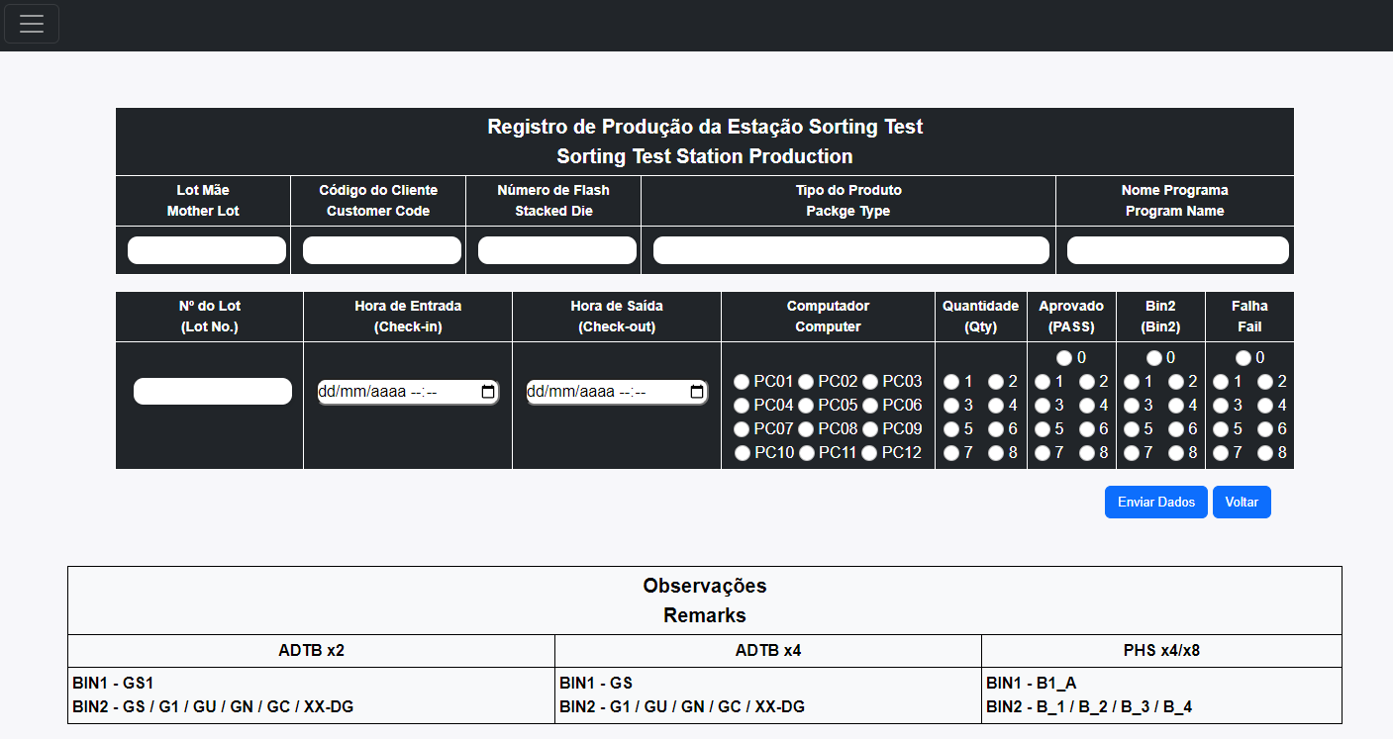
This is Tab number 1 screen

Slide 8
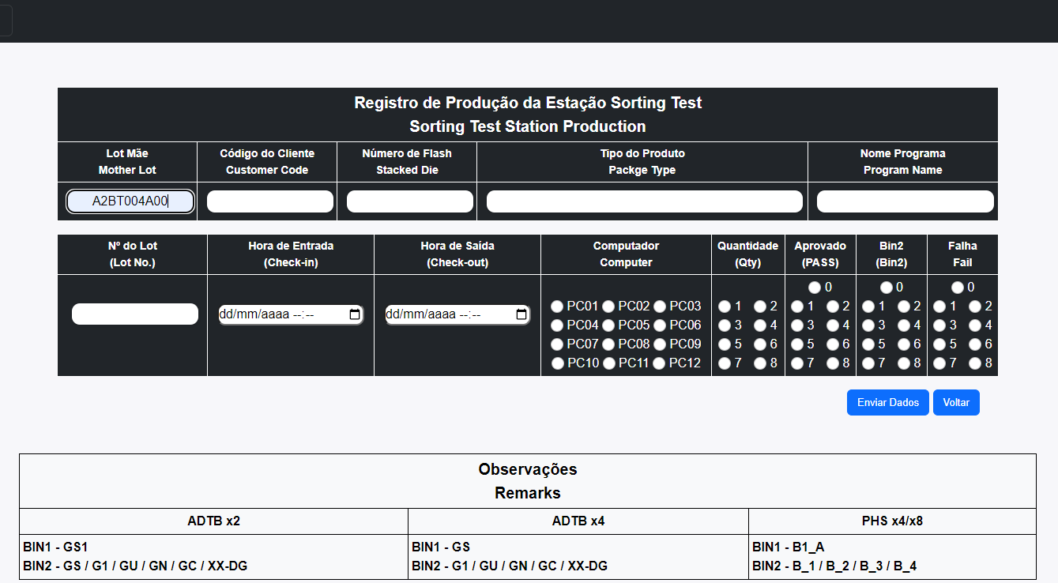
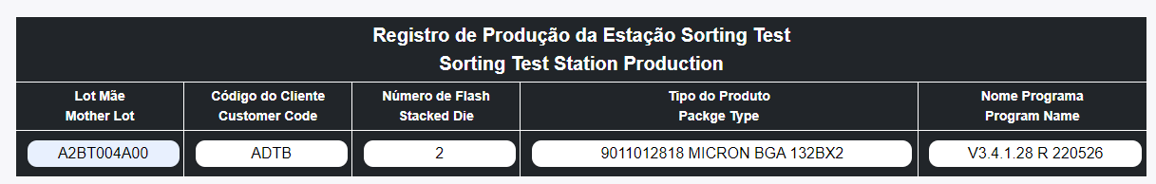
After entering the registered Mother Lot, the information will be loaded automatically, so the employee will not need to enter this information every time.

Slide 9
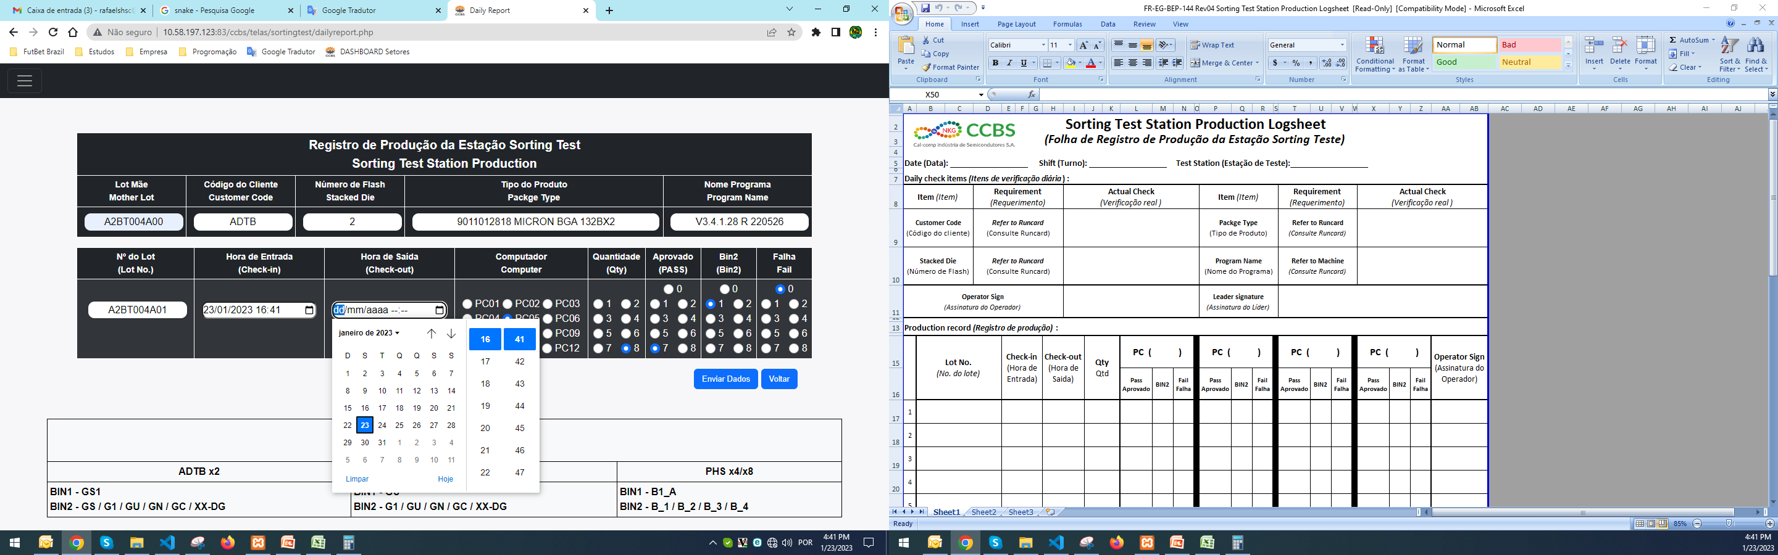
After inserting the Mother Lot and the information being loaded, just insert the Child Lot, choose the start and end time, the PC, Quantity inserted, approved quantity, quantity of Bin2 and Quantity of Failure.

Slide 10
In case you are in doubt, there is an area at the bottom of the screen that says, what is Bin1 and what is Bin2.

Slide 11
To make it easier, the employee can save the mother lot in the shortcut key (Ctrl+V), so that whenever it is necessary to place the mother lot, press the shortcut key and for the child lot, you can do the same, only being necessary to delete the last digit or the last two, the other information will only be necessary to click.

Slide 12
In this screen we will have 3 types of graphs.
1st which will show the overall performance of the last 5 days.
2nd which will show the employee's income (we can put it according to the last day, currently the general income is used, the name of engineering and other areas was used just for example).
3rd which will show the performance of the PC.
All this, as each employee sends the data.
See next slide.

Slide 13
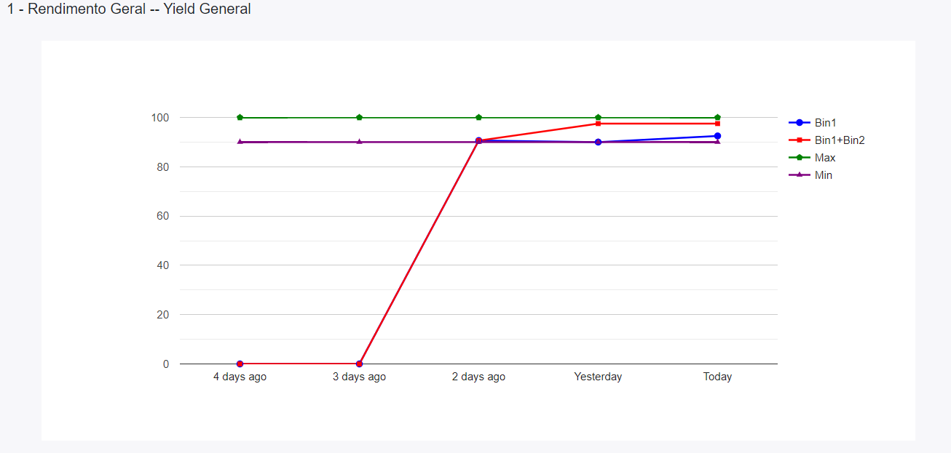

Slide 14
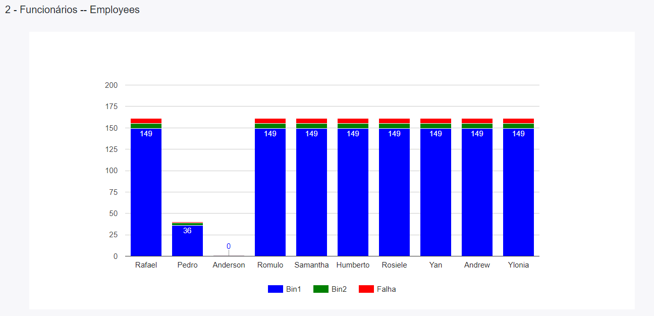

Slide 15
